Slide 1
Digital Logic & Design
Lecture 01
Engr. Amir Zahoor
Copyrights: Dr Waseem Ikram

Slide 2
Myself
Name: Engr. Amir Zahoor
M.Sc. Electrical Engineering
E-mail: amir.zahoor@nu.edu.pk
Office #: EE Dept. 119
Visiting Hours:
  Tuesday & Thursday – 10:00 -01:00

Slide 3
Logistics.
Code: EE-227
Credit Hours: 3+1
Two lectures per week each of duration 1.5 hour

Slide 4
More Logistics
Text Books
  Digital Design (Fourth Edition)
  by M. Morris Mano, Michael Ciletti
    Prentice Hall
  Logic and Computer Design Fundamentals
  by M. Morris Mano, Charles Kime
    Pearson Education

Slide 5
Marks Distributions
Class
Assignments |  | 5%
Quizzes |  | 10%
Midterm Exams |  | (15+15)%
Class Participation |  | 5%
Final Exam |  | 50%
Total |  | 100%

Slide 6

Digital Logic Design
BS(CS)
Lecture_01
National University of Computer & Emerging Sciences- CFD Campus
Department of Electrical Engineering
National University of Computer & Emerging Sciences

Slide 7
Analogue Quantities
Continuous Quantity
Intensity of Light
Temperature
Velocity
Notes:
Most of the quantities in nature that we can measure are continuous, for example the intensity of light, temperature, velocity all change continuously.
Temperature for example never rises in discrete steps like 37, 39, 43. The rise in temperature is continuous.

Slide 8
Digital Values
Discrete set of values
Notes:
Digital values on the other hand are a discrete set of values which represent the actual Continuous Signal.
Consider the continuous signal shown in the diagram.

Slide 9
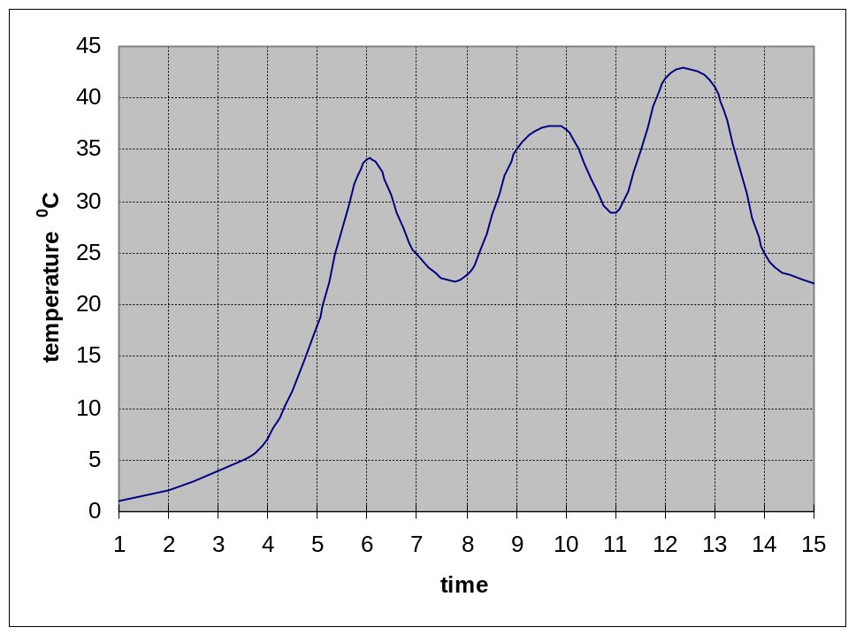
Continuous Signal
Notes:
The diagram shows a plot of temperature continuously varying with time.
The continuous signal might be representing the change in the intensity of light or velocity.
The continuous signal can be represented digitally by taking samples at regular but fixed intervals.

Slide 10
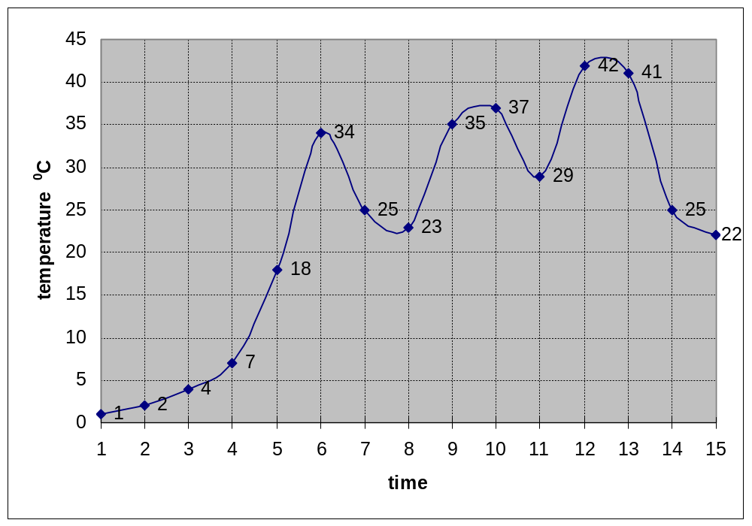
Continuous Signal
Notes:
In this case 15 samples at regular time intervals are collected.
The 15 samples having the values 1, 2,4,7,18,34,25,23,35,37,29,42,41,25 and 22 represent the continuous signal digitally.
The digital representation of the continuous signal only approximates the original signal and does not truly represent the original signal as can be seen by plotting the digital values.

Slide 11
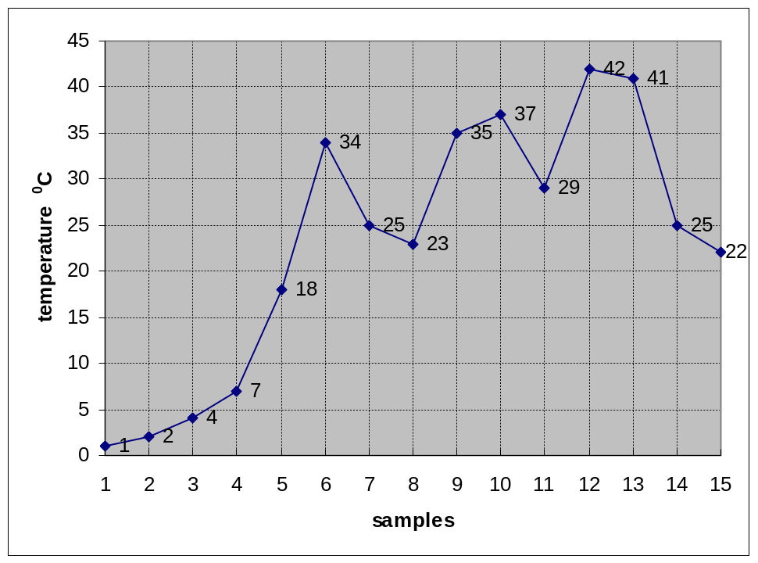
Digital Representation
Notes:
The reconstructed continuous signal does not give an exact replica of the original.
The reconstructed signal has sharp edges and corners in contrast to the original signal which has smooth curves.

Slide 12
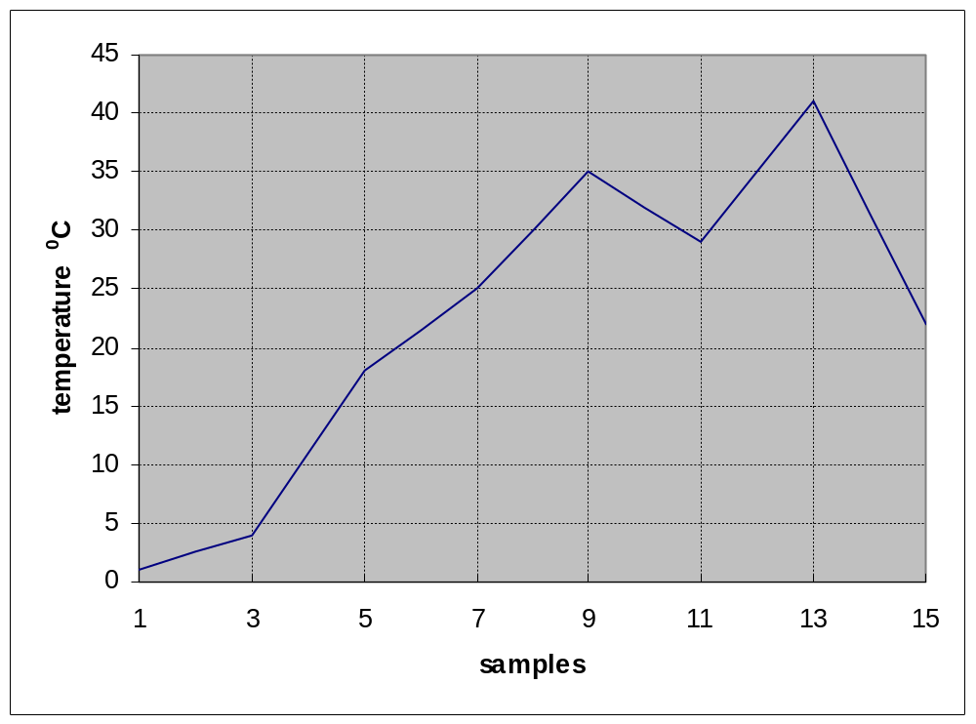
Under Sampling
Notes:
If the number of samples that are collected are reduced by half, that is samples are collected at every odd interval of time, the resulting reconstructed signal is very different from the original signal.
The peak in the continuous signal at 34 ⁰C and the dip at 23 ⁰C are all together missing from the reconstructed signal.
This is due to the small number of samples taken.
A better approximation of the original signal can be obtained by increasing the number of samples.
An infinite number of samples very accurately represent the original continuous signal.

Slide 13
Electronic Processing
Analogue Systems
Digital Systems
Representing quantities in Digital Systems
Notes:
Electronic processing of these continuous and digital quantities requires that these quantities be converted into and represented in term of voltages.
Analogue Electronic Systems deal with electronic signals or voltages that are continuous and represent continuous quantities.
Thus a temperature transducer converts a continuous temperature of 39 ⁰C into 39 mVs and 42.75 ⁰C into 42.75 mVs.
Digital Electronic Systems on the other hand deal with discrete electronic signals or voltages that represent discrete or digital values.
How does a digital system such as a calculator process the number 39? Do the Digital systems represent discrete values in terms of voltages? Lets have a look.
One possible solution is to calibrate the electronic circuitry of the calculator to represent the number 1 by 1 mV. The number 10 is represented by 10 mV. The number 39 is represented by 39 mV.

Slide 14
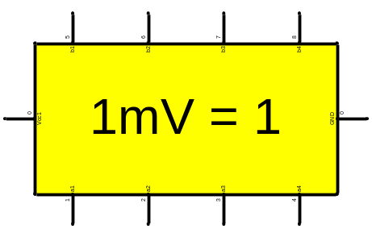
Representing Digital Values
39 ⁰C ?
Digital System
39mV
6.25 x 10¹⁵ V !!
6.25 x 10¹⁸ ?
Notes:
Consider the Calculator which is an example of a Digital system.
Let us assume that the calculator has been internally calibrated to represent the number 1 by 1mVolts.
Thus a number or temperature value 39 is represented by the calculator in terms of a voltage value as 39 mVolts.
Calculators can also handle a large values such as 6.25 x 10¹⁸ the number of electrons in 1 Coulomb of charge.
This large value represented in terms of voltage by the calculator, turns out to be 6.25 x 10¹⁵ volts, which is a very large voltage value and can not be practically represented by any circuit.

Slide 15
Digital Systems
Two Voltage Levels
Two States
  On/Off
  Black/White
  Hot/Cold
  Stationary/Moving
Notes:
Digital systems use electronic circuitry that only works with two voltage levels. The two voltage levels represent two states. A voltage level of 5v represents logic high or logic 1 state and a voltage level of 0v represents logic low or logic 0 state.
The two states in a digital system can represent any two quantities, the numbers 0/1, on/off, black/white, hot/cold, moving/stationary and similar other quantities.
How does one represent more than two states in a digital system?
Such as the different shades of grey in between the colours black and white or the temperature 39 or the velocity of a moving object.

Slide 16
Binary Number System
Binary Numbers
Representing Multiple Values
Combination of 0v & 5v
Notes:
The two states of the Digital circuits are based on the Binary number system which allows only two numbers 0 and 1.
The Binary digit is called a bit.
To represent more than two states a combination of binary bits is used.
In the decimal number system a single digit can represent 10 values from 0 to 9.
To represent more than 10 values a combination of two digits is used which allows up to 100 values to be represented.
In a binary number system a combination of 2 bits allows 4 different values to be represented.
For example the four shades are represented by two bits, 00, 01, 10, 11.
A temp of 39 is represented by a combination of six bits 100111.
The number 39 is represented in a digital system by a combination of voltage levels 5, 0, 0, 5, 5 and 5 volts

Slide 17
Merits of Digital Systems
Efficient Processing & Data Storage
Efficient & Reliable Transmission
Detection and Correction of Errors
Precise & Accurate Reproduction
Easy Design and Implementation
Occupy minimum space
Notes:
Let us have a quick look at the advantages of a Digital System.
Processing and Storage of digital data is efficient.
Computers are very efficient at processing information that is in digital binary form.
A CD can store large number of digitized audio and video clips. Storing same number of audio or video clips in an analogue form requires a large number of audio or video cassettes.
Transmission of digital data is efficient and reliable and less prone to errors.
Even if an error occurs detection and correction of errors in digital data is easier.
We will be looking at a simple example of detecting errors using the parity bit method.
Digitally stored data can be precisely and accurately reproduced.
The picture quality and sound quality of digitized video or audio stored on CDs can be reproduced with a far superior quality as compared to analogue audio and video.
Digital circuits and systems are easier to design and implement.
We would be looking at some simple digital systems in the Digital Logic Design course.
Digital circuits in the form of Integrated circuits occupy very small space.
The PC has a motherboard which has an area less than 1 sq.ft but has all the important circuitry of the computer.
Digital memory implemented as an Integrated circuit small enough to fit in you hand can store an entire collection of books!

Slide 18
Information Processing
Numbers
Text
Formula and Equations
Drawings and Pictures
Sound and Music
Notes:
A computer which is a digital system can process different types of information
It can handle numbers and perform arithmetic operations on the numbers
It can handle text and perform editing operations on text
It can handle mathematical and scientific formulas
It can handle drawings and pictures
It can process sound and music
All this diverse types of information is represented in the form of binary numbers. Different binary standards are used to represent different types of information. For example, text is represented through binary bits, however the bits representing the characters follow a standard ASCII code

Slide 19
Logic Gates
Building Blocks
AND, OR and NOT Gates
NAND, NOR, XOR and XNOR Gates
Integrated Circuits (ICs)
Notes:
How does the digital circuit process the binary information?
As mentioned earlier, the digital circuits are designed to work with binary numbers.
Logic Gates which are the Basic building blocks of a complex digital system which perform simple but unique operations on the binary or digital information.
The basic Logic Gates are the AND Gate, OR Gate and the NOT Gate.
Each of these three gates performs unique logical operations on the information applied at the inputs. The result of the operation is available on the output of the gate.
Other gates that are also frequently used are NAND, NOR, XOR and XNOR. The four gates are symbolically represented in the diagram.
All these gates are available in the form of Integrated Circuits (ICs)

Slide 20
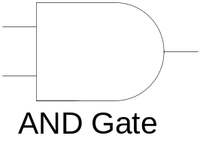
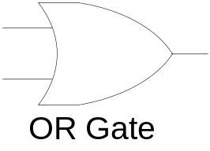
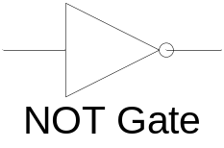
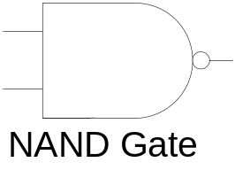
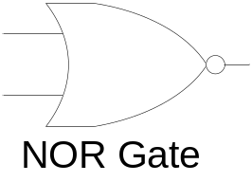
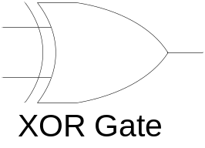
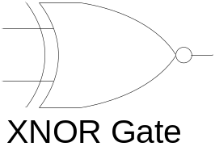

Logic Gate Symbol and ICs
c
3
2
1
0
c
1
1
1
1
9
8
V
7400
D
1
2
3
4
5
6
N
G
Notes:
Each gate is shown to have two inputs except for the NOT gate.
The six gates can have more than two inputs.
All logic gates always have a single output.
The Integrated Circuit shows a NAND Gate IC which has four dual input NAND gates.
Such ICs with different gates are available and used for implementing digital circuits.

Slide 21
Combinational Circuits
Combination of Logic Gates
Adder Combinational Circuit
Notes:
The Logic gates by them selves are not able to do anything useful. These gates have to be connected together to form a circuit which is able to perform some useful function. A circuit formed by the combination of logic gates is known as a combinational circuit.
An Adder combination circuit is shown in the diagram.

Slide 22
Adder Combinational Circuit
Sum
Carry
Notes:
An Adder circuit is formed by the combination of AND, OR and XOR gates and is able to add two single bit binary numbers.
Combinational circuits perform an operation on the input binary information and results in an output which is almost instantaneous.
Many of these combinational circuits that perform a specific function such as addition are available as MSI Integrated Circuits (ICs) and are known as functional devices.
Other commonly used Functional devices are

Slide 23
Functional Devices
Functional Devices
  Adders
  Comparators
  Encoders/Decoders
  Multiplexers/Demultiplexers
Notes:
Commonly used functional ICs are
Adder
Comparator
Encoder/Decoder
Multiplexer/Demultiplexer

Slide 24
Sequential Circuits
Memory Element
Current & Previous State
Flip-Flops
Counters & Registers
Notes:
Digital systems are being used in a wide variety of applications. A large number of these digital systems generate an output based on not only the current information but some previously stored information.
Consider a timer circuit, counting in reverse from 10 to 0. The timer circuit decrements the count by 1 each time it receives an input signal. The new count value is dependent on the previous count value.
Consider the block diagram of a Sequential circuit.

Slide 25
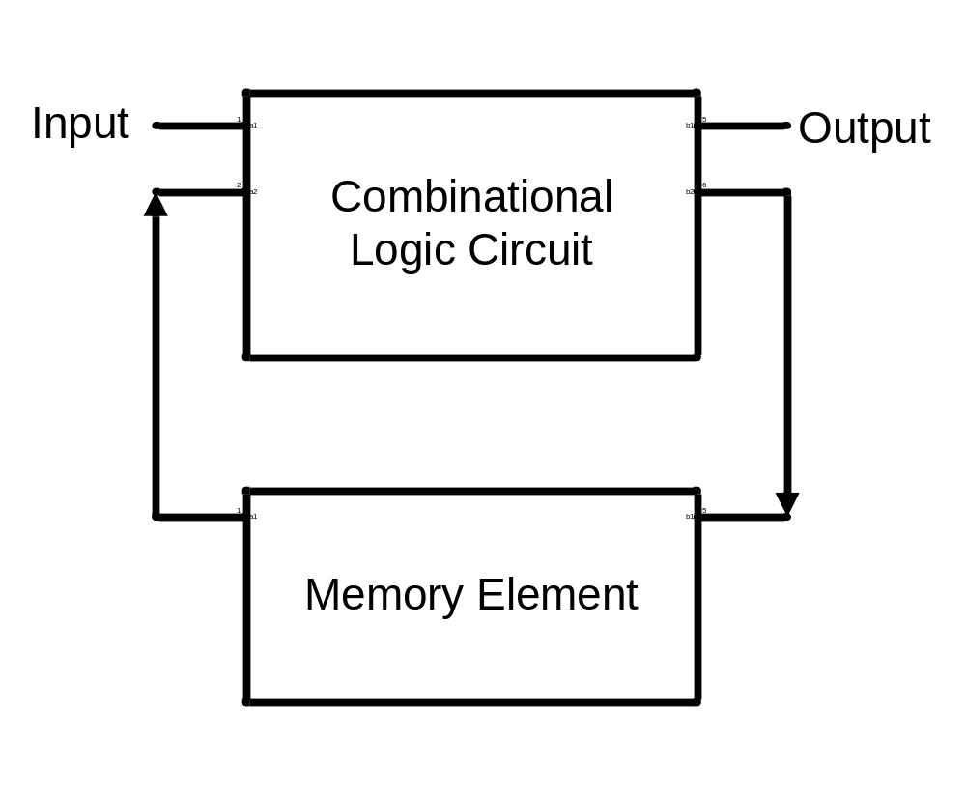
Block Diagram of a Sequential Circuit
Notes:
The Sequential circuit consists of a Combinational part and a memory element.
Consider the timer of a microwave oven. You key in the time to cook your favourite dish.
The microwave display unit displays the cooking time.
The memory element of the microwave oven sequential circuit stores the cooking time.
The cooking time is decremented by 1 after every second when a new input signal is received at the input of the combinational part of the Sequential circuit.
Ultimately, when the cooking time decrements to zero and the memory element stores zero , the next input signal sounds an alarm and turns the microwave off.
A traffic signal controller operates in a similar manner. It switches between the green, amber and red signal in a sequence on the basis of current and previous information.
The memory or storage element in the Sequential Circuit is implemented using a very simple digital circuit known as a flip-flop.
Examples of Sequential circuits are Counters and Registers. These Sequential circuits are available as MSI ICs.

Slide 26
Programmable Logic Devices (PLDs)
Configurable Hardware
Combinational Circuits
Sequential Circuits
Low chip count
Lower Cost
Short development time
Notes:
A modern trend in implementing digital systems is through Programmable Logic Devices or PLDs.
PLDs provide the user with a general purpose circuitry which the user can configure or program to form any combinational or Sequential functional unit.
The adder circuit discussed earlier is a combinational circuit that uses AND, OR and XOR Gates. Thus three different ICs have to be used to implement an adder.
A PLD based implementation only requires a single chip.
The use of PLDs in implementing combinational and sequential circuits results in fewer ICs and thus lower costs. The implementation time is also short.

Slide 27
Memory
Storage
RAM (Random Access Memory)
  Read-Write
  Volatile
ROM (Read-Only Memory)
  Read-Only
  Non-Volatile
Notes:
Memory is an important requirement of a digital system. Besides its use to implement sequential circuits, large memory is required to store information in computer systems. Essentially memory is of two types.
RAM (Random Access Memory) which also stored information to be read or modified.
RAMs are volatile, that is if the power is turned off, the contents stored in the memory are lost.
ROM (Read-Only Memory) as the name specifies allows only read operations. No new information is allowed to be written into the memory.
ROMs are non-volatile and retain the information even if the power is turned off.

Slide 28
A/D & D/A Converters
Processing of Continuous values
Conversion
  Analogue to Digital A/D
  Digital to Analogue D/A
Industrial Control Application
Notes:
Real-world quantities as mention earlier are continuous in nature and have widely varying ranges. Processing of real-world information can be efficiently and reliably done in the digital domain.
This requires real-world quantities to be read and converted into equivalent digital values which can be processed by a digital system. In most cases the processed output needs to be converted back into real-world quantities.
Two conversions are required, one from the real-world to the digital domain and then back from the digital domain to the real-world.
Modern digitally controlled industrial units extensively use Analogue to Digital (A/D) and Digital to Analogue (D/A) converters to covert quantities represented as an analogue voltage into an equivalent digital representation and vice versa.
The diagram shows a chemical reaction vessel being heated to expedite the chemical reaction.

Slide 29
Digital Industrial Control
Digital
* / *
* / *
x
1
u
1
x
1
u
1
Controller
A/D
D/A
Converter
Converter
Thermocouple
Reaction
Vessel
Heater
Control
Notes:
Temperature of the vessel is monitored to control the chemical reaction.
As the temperature of the vessel rises the heat has to be reduced by a proportional level.
An electronic temperature sensor converts the temperature into an equivalent voltage value. This voltage value is continuous and proportion to the temperature.
The voltage representing the temperature is converted into a digital representation which is fed to a digital controller circuit that generates a digital value corresponding to the desired amount of heat.
The digitized output representing the heat is converted back to a voltage value which is continuous and is used to control a valve that regulates the heat.
An A/D converter converts the analogue voltage value representing the temperature into a corresponding digital value for processing.
A D/A converter converts back the digital heat value to its corresponding continuous value for regulating the heater.
A/D and D/A converters and there interface with the real and digital word is an important aspect of digital systems.

Slide 30
Summary
Continuous Signals
Digital Representation in Binary
Information Processing
Logic Gates
Notes:
We have discussed that many of the measurable quantities in nature are continuous
For efficient processing these continuous signals are digitized and represented as binary voltage values
Digital systems are able to process different types of information such as numbers, text, drawings, pictures and sound.
All this different type of information is represented digitally in terms of binary numbers.
Logic Gates are the basic building blocks of all digital circuits and these gates are able to perform simple logical operations on binary information.

Slide 31
Summary
Combinational & Sequential Circuits
Programmable Logic Devices (PLDs)
Memory (RAM & ROM)
A/D & D/A Converters
Notes:
Practical digital circuits are formed by combining various logic gates. Such circuits are known as combinational circuits.
Sequential circuits are a combination of combinational circuits with a storage element.
PLDs are available as general purpose configurable Integrated Circuit.
Users can program a PLD to implement any combinational or sequential circuit.
Memory is an essential part of any digital system.
Memory is used to store information.
Two types of memory, RAM and ROM are used.
Finally, we looked at A/D and D/A converters.
A/D and D/A converters allow conversion of analogue values to digital values and vice versa.
These converters allow digital systems to process and control real world quantities.

Slide 32
Number Systems and Codes
Decimal Number System
Caveman Number System
Binary Number System
Hexadecimal Number System
Octal Number System
Notes:
Let us start our discussion with Number Systems.
Earlier we have discussed that Digital Systems can process different types of information such as numbers, text, pictures and sound which are represented in the form of Binary numbers.
For understanding the Digital System we need to be fully aware of the Binary Number System and should be able to perform all the functions and operations that we have been performing using the Decimal Number System.
We would be looking at five different Number Systems.
We will start our discussion with the Decimal Number system. We are already aware of the Decimal number system and have been using the decimal number system since our school days.
Next we would be discussing a hypothetical Caveman Number System. I am using the Caveman number system as an example to introduce a Number system which is different from the decimal number system.
The third Number System that I would be discussing is the Binary Number System used by digital systems
The last two number systems that I would be mentioning are the Hexadecimal and the Octal Number systems.

Slide 33
Decimal Number System
Ten unique numbers 0,1..9
Combination of digits
Positional Number System
275 = 2 x 10² + 7 x 10¹ + 5 x 10⁰
  Base or Radix 10
  Weight 1, 10, 100, 1000 ….
Notes:
The decimal number system has ten unique digits 0, 1, 2, 3… 9
Using these single digits, ten different values can be represented
To represent values greater than ten, the digits have to be used in different combinations. Thus ten is represented by the number 10, two hundred seventy five is represented by 275 etc. Thus same set of numbers 0,1 2… 9 are repeated in a certain order.
The decimal number system is a positional number system as the position of a digit represents its true magnitude. For example 2 is less than 7, however 2 in 275 represents 200, whereas 7 represents 70. The left most digit has the highest weight and the right most digit has the lowest weight.
The weight of subsequent digits increases by a factor of 10 towards the left starting with 1 as the weight of the right most digit or the least significant digit.
275 can be written as 2 x 10² + 7 x 10¹ + 5 x 10⁰ = 200 + 70 + 5 = 275
The 10 represents the base or radix
10², 10¹, 10⁰ represent the weights 100, 10 and 1 of the numbers 2, 7 and 5

Slide 34
Representing Fractions
Fractions can be represented in decimal number system in a manner
= 3 x 10² + 8 x 10¹ + 2 x 10⁰ + 9 x 10⁻¹
+ 1 x 10⁻²
= 300 + 80 + 2 + 0.9 + 0.01
= 382.91
Notes:
Fractions can be represented in decimal number system in a manner similar to that of representing integers.
The weight of the digit to the immediate right of the decimal point has a weight 10^{-1.}
Weights of subsequent digits decreases by a factor of 10.
Thus 382.91 can be written in terms of the base number and weights as
3 x 10² + 8 x 10¹ + 2 x 10⁰ + 9 x 10⁻¹ + 1 x 10⁻²
Solving the expression results in five terms 300, 80, 2, 0.9 and 0.01 which sum up to 382.91

Slide 35
Caveman Number System
∑, ∆, >, Ω and ↑
Base – 5 Number System
∆Ω↑∑ = 220
Notes:
Now let us see how numbers can be represented in a new number system.
A number system discovered by archeologists in a prehistoric cave indicates that the caveman used a number system that has 5 distinct symbols ∑, ∆, >, Ω and ↑. (Sigma, Delta, Greater than, Omega and Arrow)
Furthermore it has been determined that the five symbols represents the decimal equivalents of numbers 0 to 4 respectively.
Which number is the Caveman using?
Since there are 5 unique symbols specifying 5 values. Therefore the Caveman is using a Base 5 number system.
The number ∆Ω↑∑ in Base 5 number system represents 220 in decimal.
Before we see how ∆Ω↑∑ represents 220 in decimal, let us see the Caveman Number representations of the decimal number system.

Slide 36
Caveman Number System
Decimal Number | Caveman Number | Decimal Number | Caveman Number
0 | ∑ | 10 | >∑
1 | ∆ | 11 | >∆
2 | > | 12 | >>
3 | Ω | 13 | >Ω
4 | ↑ | 14 | >↑
5 | ∆∑ | 15 | Ω∑
6 | ∆∆ | 16 | Ω∆
7 | ∆> | 17 | Ω>
8 | ∆Ω | 18 | ΩΩ
9 | ∆↑ | 19 | Ω↑
Notes:
The caveman can represent the first five decimal numbers (0-4) using a single digit of the caveman number system as shown in the table.
To represent higher values (5-9) a combination of two digits is used.
What should be the most significant digit?
Just think, how do you represent a value greater than 9 in the decimal system?
In a decimal number system after counting up to 9, two digits are used. The most significant digit is fixed at the next highest value 1, and the least significant digit varies between 0 and 9 (10 to19). After 19, the most significant digit is set to 2 and the least significant digit varies between 0 and 9 (20-29) and so on.
Thus in the caveman number system the most significant digit is ∆, and the least significant digit varies between ∑ to ↑. The caveman representation of decimal numbers 5 to 9 is shown in the table.
In a decimal number system how do we represent number after 19? The most significant digit is increased to the next value (from 1 to 2) and the least significant varies between 0 and 9.
Thus in the caveman number system same procedure is followed. The table shows the Caveman number system equivalents to the first 20 decimal values.

Slide 37
Caveman Number System
Mr. Caveman is using a base 5 number system. Thus the number ∆Ω↑∑ in decimal is
= ∆ x 5³ + Ω x 5² + ↑ x 5¹ + ∑ x 5⁰
= ∆ x 125 + Ω x 25 + ↑ x 5 + ∑ x 1
= (1) x 125 + (3) x 25 + (4) x 5 + (0) x 1
= 125 + 75 + 20 + 0 = 220
Notes:
Let us see how the caveman number ∆Ω↑∑ represent 220 in decimal.
The number ∆Ω↑∑ can be easily converted into decimal if we write an expression for the Caveman number ∆Ω↑∑ in terms of the base number and the weights.
What is the base number of the caveman number system? 5.
What is the weight of the most significant digit of the number ∆Ω↑∑? 5³
Similarly the weights of the digits Ω, ↑ and ∑ are 5², 5¹ and 5⁰ respectively.
The weights of the four digits starting from the most significant digit are 125, 25, 5 and 1
The weights change by a factor 5.
Thus writing the number ∆Ω↑∑ in terms of an expression is ∆ x 5³ + Ω x 5² + ↑ x 5¹ + ∑ x 5⁰
Replacing the caveman numbers by their decimal equivalents changes the expression to 1 x 5³ + 3 x 5² + 4 x 5¹ + 0 x 5⁰
Solving the expression gives four terms 125, 75, 20 and 0. Adding the four terms gives the result 220.

Slide 38
Binary Number System
Two unique numbers 0 and 1
Base – 2
A binary digit is a bit
Combination of bits to represent larger values
Notes:
Digital systems as mentioned earlier use a Binary number system.
Binary as the name indicates is a base 2 number system having only two values 0 and 1.
A binary digit is known as a Bit.
Similar to other number systems the Binary Number System uses a combination of digits or Bits to represent numbers larger than 0 and 1.
Lets have a look at Binary Representation of Decimal Numbers.

Slide 39
Binary Number System
Decimal Number | Binary Number | Decimal Number | Binary Number
0 | 0 | 10 | 1010
1 | 1 | 11 | 1011
2 | 10 | 12 | 1100
3 | 11 | 13 | 1101
4 | 100 | 14 | 1110
5 | 101 | 15 | 1111
6 | 110 | 16 | 10000
7 | 111 | 17 | 10001
8 | 1000 | 18 | 10010
9 | 1001 | 19 | 10011
Notes:
A single binary bit can represent only two decimal values 0 and 1.
To represent the next two decimal values, two binary bits are used. The most significant bit remains fixed at 1 and the least significant bit changes between 0 and 1. Thus decimal numbers 2 and 3 are represented by two bit binary numbers 10 and 11 respectively.
How are the decimal numbers 4 and 5 represented?
The decimal numbers 4 and 5 are represented by a combination of 3 bits. The most significant two bits remain fixed and the least significant bit changes between 0 and 1.
Higher decimal numbers can be represented in binary by using a larger combination of bits.
The Binary representations of the first 20 decimal numbers are shown in the table.

Slide 40
Combination of Binary Bits
Combination of Bits
10011₂ = 19₁₀
= (1 x 2⁴) + (0 x 2³) + (0 x 2²) + (1 x 2¹)
+ (1 x 2⁰)
= (1 x 16) + (0 x 8) + (0 x 4) + (1 x 2)
+ (1 x 1)
= 16 + 0 + 0 + 2 + 1
= 19
Notes:
Don’t worry, if you have not understood the binary representation. We would be discussing binary numbers through the course.
Let us find out what does the Binary combination 10011₂ represent? It represents the decimal number 19.
Let us see how the Binary number 10011₂ represent decimal 19?
The decimal equivalent of a combination of binary number can easily be found by writing an expression in terms of the base value and weights as we did earlier with the caveman number system.
What is the base number of binary number system? 2
What are the weights of the 5 bits 10011? Starting from the most significant left most bit the weights are 2⁴, 2³, 2², 2¹ and 2⁰.
Writing an expression in terms of the binary bits and the respective weights results in the expression (1 x 2⁴) + (0 x 2³) + (0 x 2²) + (1 x 2¹) + (1 x 2⁰)
Solving the expression results in five terms 16, 0, 0, 2 and 1, which sum up to 19.
The subscript 2 indicates that the number 10011 is binary and not decimal ten thousand eleven.
The weights of the 5 bits starting from the left, most significant bit are 16, 8, 4, 2 and 1.
The weights in a Binary Number system change by a factor of two.
The most significant bit on the extreme left has the highest weight.
In the decimal number and the caveman number system the weights increased by a factor of 10 and 5 respectively.

Slide 41
Fractions in Binary
Fractions in Binary
1011.101₂ = 11.625
  = (1 x 2³) + (0 x 2²) + (1 x 2¹) + (1 x 2⁰)
  + (1 x 2⁻¹) + (0 x 2⁻²) + (1 x 2⁻³)
  = (1 x 8) + (0 x 4) + (1 x 2) + (1 x 1)
  + (1 x 1/2) + (0 x 1/4) + (1 x 1/8)
  = 8 + 0 + 2 + 1 + 0.5 + 0 + 0.125
  = 11.625
Floating Point Notations
Notes:
Both integers and fractions can be represented in the Binary number system just like in the decimal number system.
The number 1011.101₂ is equivalent to decimal 11.625
Let us see how?
Calculating the decimal equivalent of a binary number representing a fraction can easily be done by writing the expression in terms of the base value and weights as was done in the case of integer numbers.
The binary number 1011.101₂ has an integer part 1011 having the weights 2³, 2², 2¹ and 2⁰.
The fraction part 101 has the weights 2⁻¹, 2⁻² and 2⁻³.
The weights of the fraction part of the binary number decrease by a factor of 2 starting from the bit immediately to the right of the decimal point.
(1 x 2³) + (0 x 2²) + (1 x 2¹) + (1 x 2⁰) + (1 x 2⁻¹) + (0 x 2⁻²) + (1 x 2⁻³)
Multiplying the weights with the corresponding decimal equivalents of the binary bits results in the terms 8, 0, 2, 1, 0.5, 0 and 0.125 which add up to give 11.625
One last word on binary representation of fractions. Computers do handle numbers such as 11.625 that have an integer part and a fraction part. However, it does not use the binary representation 1011.101. Such numbers are represented and used in Floating-Point Numbers notation which will be discussed latter

Slide 42
Decimal-Binary Conversion
Binary to Decimal Conversion
  Sum-of-Weights
  Adding weights of non-zero terms
Decimal to Binary Conversion
  Sum-of-Weights (in reverse)
  Repeated Division by 2
Notes:
The Decimal number system is used to represent and handle numbers in the Real world.
On the other hand the Binary number system is used in the digital world.
We should be able to convert from decimal to binary and vice versa.
To convert from Binary to Decimal the Sum-of-Weights method is used, as we have been doing.
A second quicker method is to add weights of only the non-zero terms
Converting from Decimal to Binary is done by using the Sum-of-Weights method in reverse.
The other method used is the repeated division by 2.

Slide 43
Decimal to binary conversion using
Sum of weight
Number | Weight | Result after subtraction | Binary
392 | 256 | 392-256=136 | 1
136 | 128 | 136-128=8 | 1
8 | 64 |  | 0
8 | 32 |  | 0
8 | 16 |  | 0
8 | 8 | 8-8=0 | 1
0 | 4 |  | 0
0 | 2 |  | 0
0 | 1 |  | 0

Slide 44
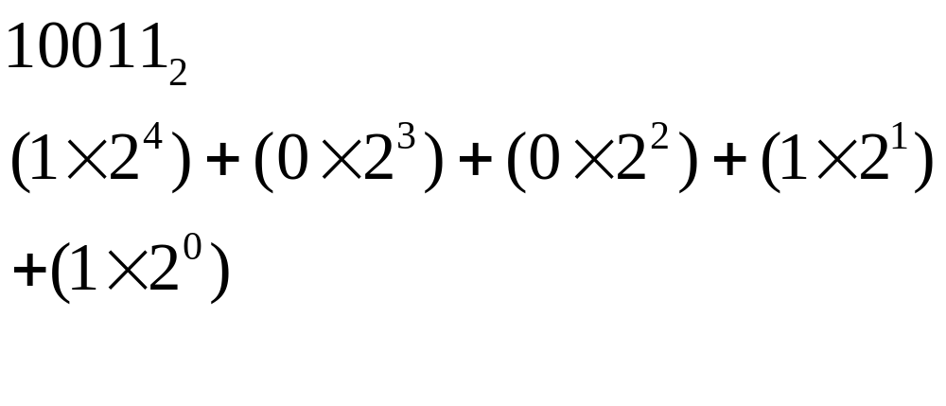
Decimal-Binary Conversion
Binary to Decimal Conversion
  Sum-of-Weights
  Adding weights of non-zero terms
Terms 16,0,0,2 and 1=
19

Slide 45
Decimal-Binary Conversion
Binary to Decimal Conversion
  Sum-of-Weights
  Adding weights of non-zero terms

Slide 46
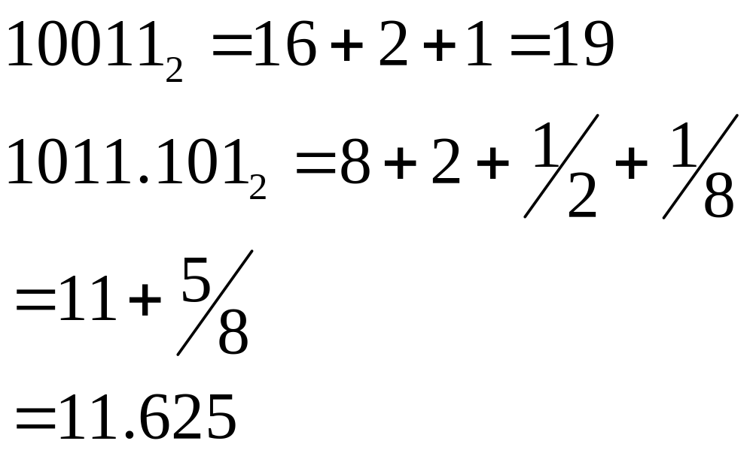
Decimal-Binary Conversion
Binary to Decimal Conversion
  Sum-of-Weights
  Adding weights of non-zero terms

Slide 47
Lecture No. 1
Number Systems
A Summary
Notes:
The second part of the first lecture on Number Systems ends here.
In this part we have discussed the decimal number system and looked at representing integers and fractions in decimal.
We have looked at a hypothetical base 5 caveman number system.
We have also discussed the binary number system used by digital systems.
We have learned to calculate decimal equivalents of base 5 caveman numbers and binary numbers by writing and solving expressions based on weights and base values.
We would be continuing with the discussion on number systems in the next lecture by looking at methods to convert from Decimal to Binary and Binary to Decimal number systems.
Please do try to practice writing numbers in caveman and binary number systems and calculating their decimal equivalents.
Khuda Hafiz and Asalam O Aleikum

